Slide 1

Air Canvas
-Python Thinkers

Slide 2
Project: Air Canvas
Team: Python Thinkers
Team Members
Anto Francis (C0825095)
Omer Volkan Guney(C0831373)
Rupesh Chandran(C0826779)
Sachin Sreekumar (C0825096)
Reporting Week: 22nd Jan 2022 – 28th Jan 2022
Supervised by
Prof. Parissa Naraei

Slide 3
Week’s Update
Familiarised with Jira
Identified the tasks within each module and assigned each task to respective team members in Jira.
Discussed about the challenges in implementation.

Slide 4
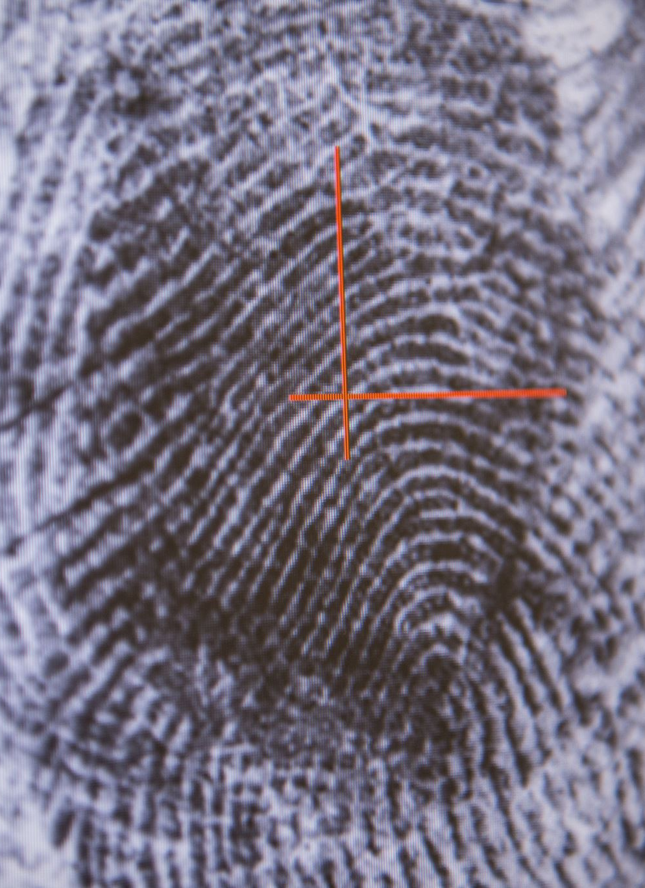
Challenges
Fingertip Detection
Lack of pen up and down movement
Plotting hand gestures in real time

Slide 5

Learnings
Different Libraries in OpenCV
Understanding the HSV (Hue, Saturation, Value) color space for Color Tracking.

Slide 6
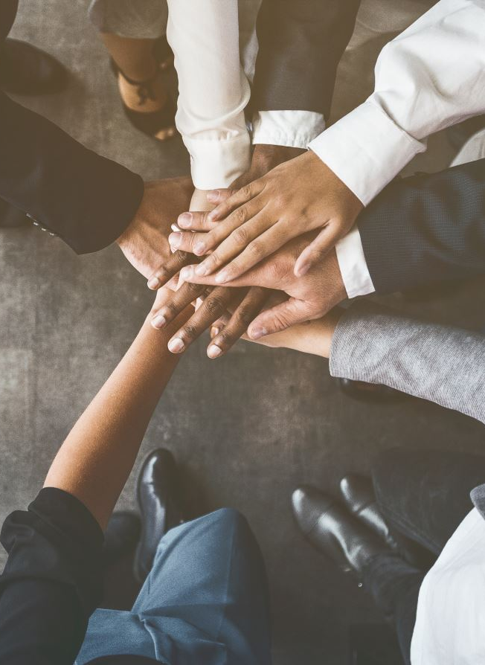
Team Collaboration
Microsoft Teams
Tuesdays & Thursdays 3:00 pm – 4:00 pm

Slide 7

Task Outline for Next Week
Research and find solutions for the challenges identified in the implementation of the project.
Explore and familiarise the libraries required for the tasks.
Break already identified tasks inti smaller tasks if possible.
Explore future aspects of the project.

Slide 8
Future Scope
Detect the tip of the finger without using collared object
Mobile Application

Slide 9

Thank you

